Slide 1
To Read or Not to Read
Gabe Maughan, Rich Holme, Jeni Levine

Slide 2
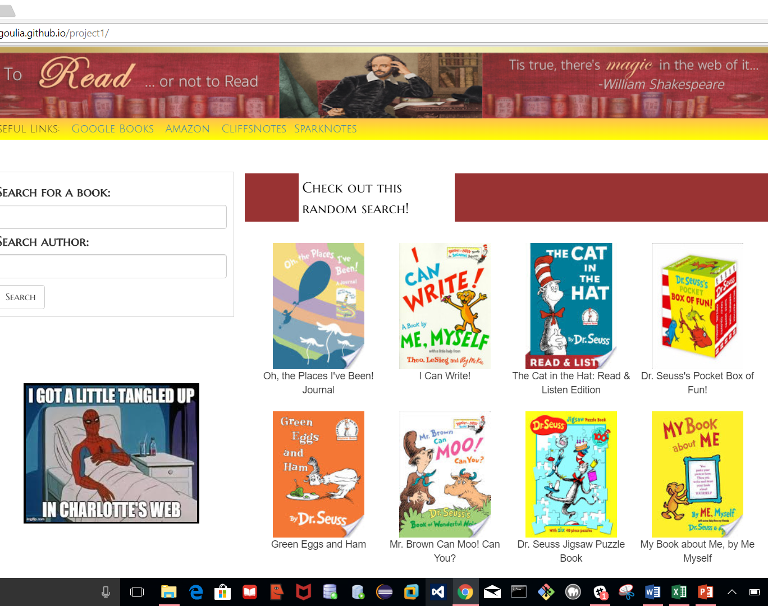
Home Page
The home page defaults to ten books by Dr. Seuss.
There is a search box for the book’s title. There is also an optional search box for the author.
A few useful links appear at the top of the page.

Slide 3
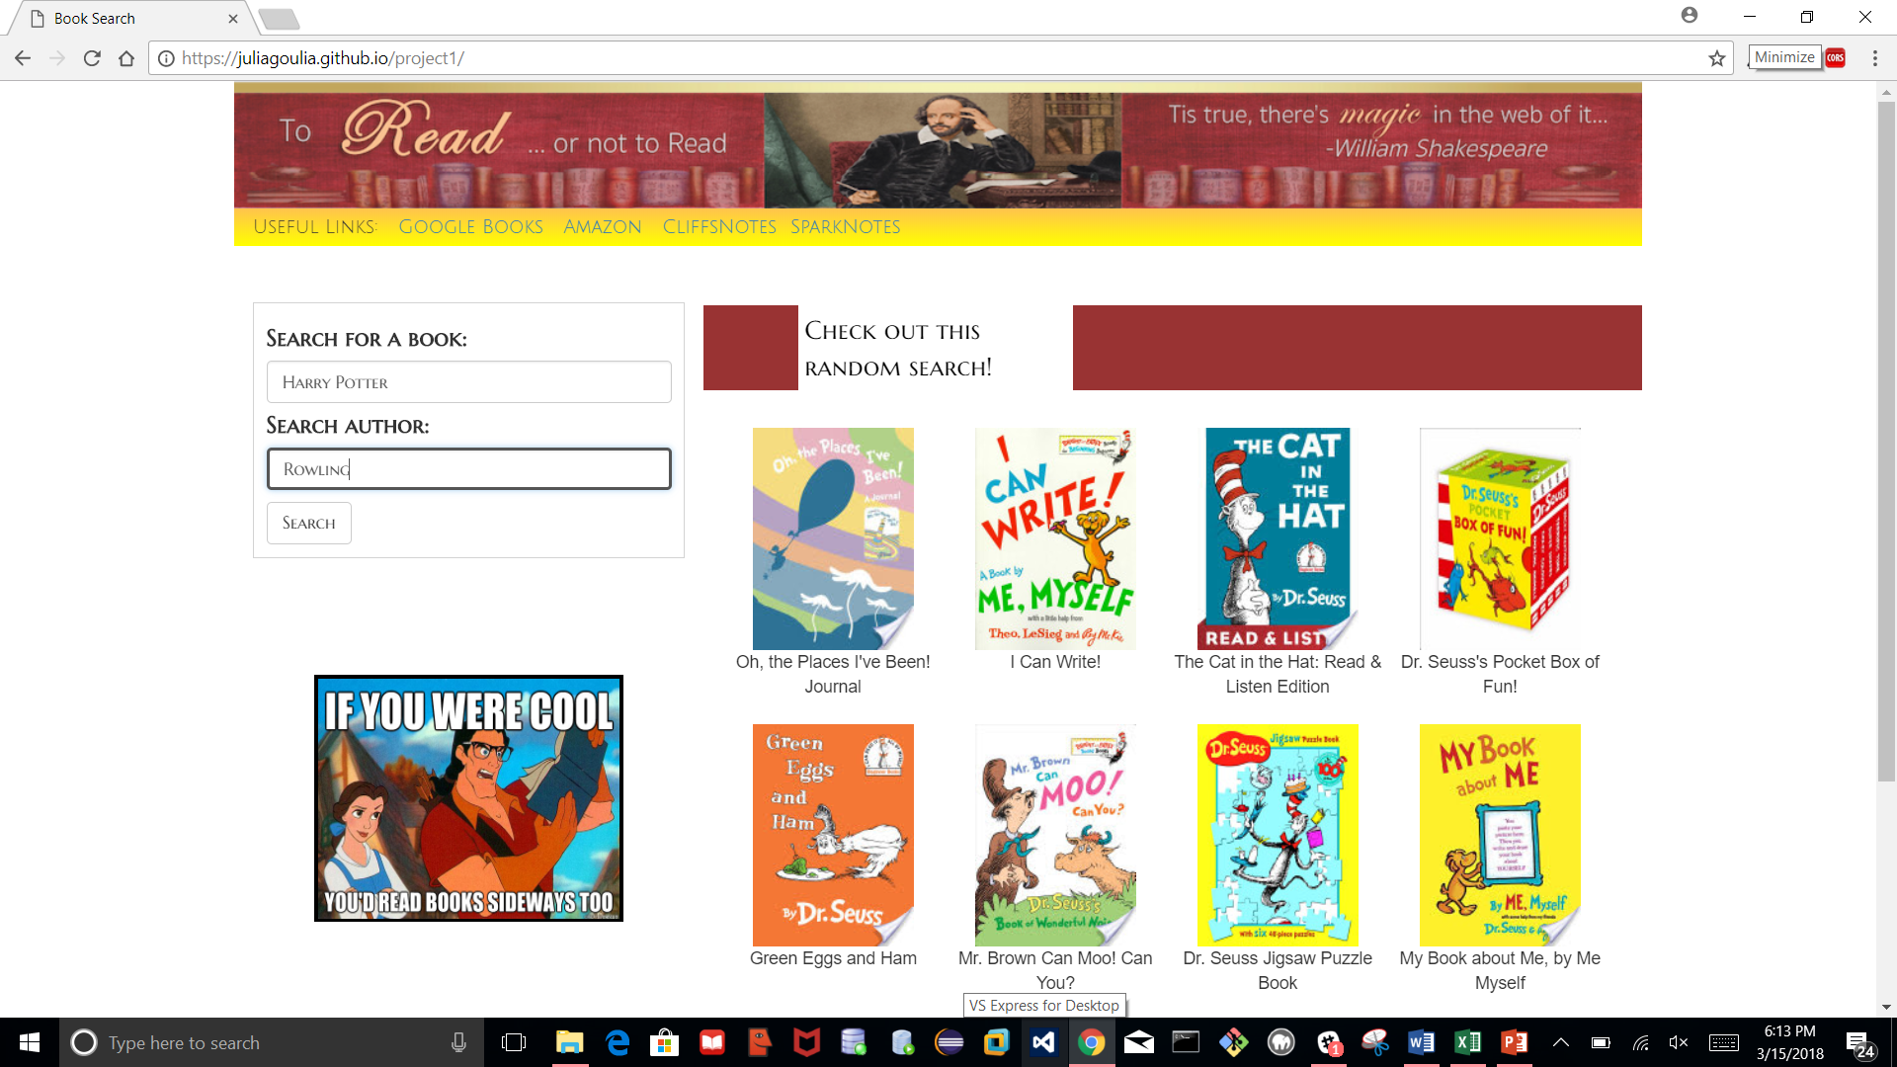
Search title: Harry Potter / author: Rowling

Slide 4
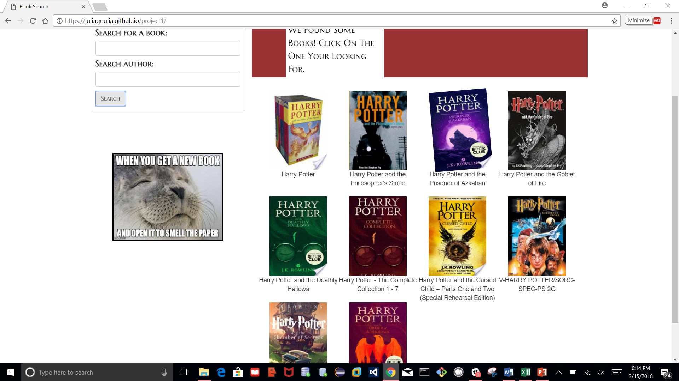
View ten results. Google books api engaged!

Slide 5
Choose a book and click

Slide 6
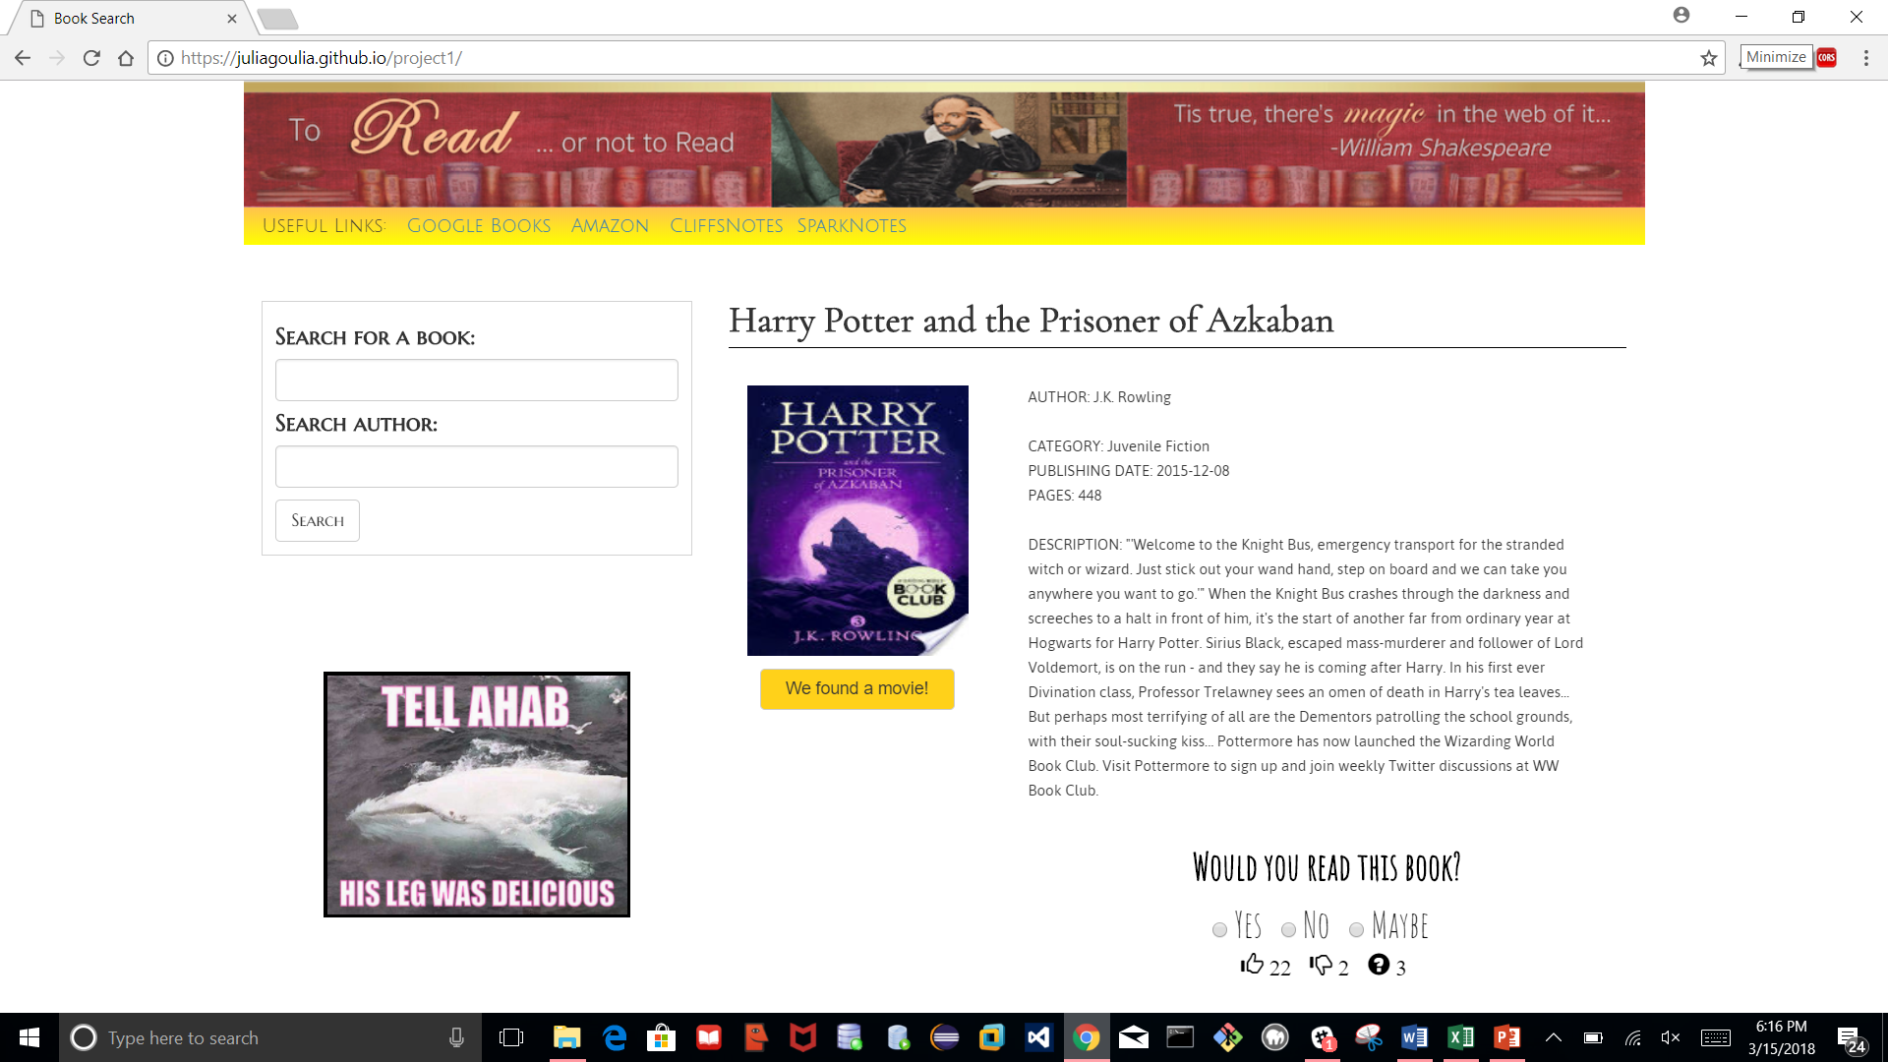
Notice the book’s descriptions as well as a poll. The poll is linked to firebase. If a movie exists, you may click on the yellow box to view info.

Slide 7
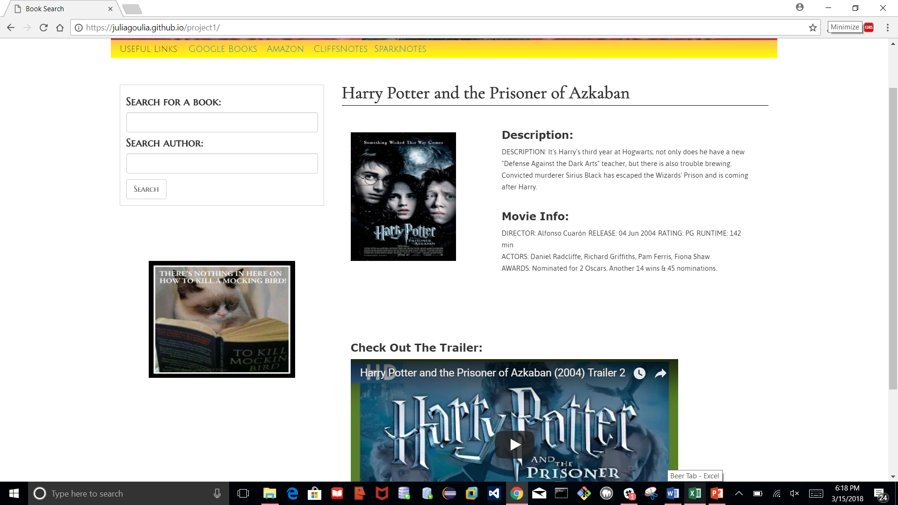
OMDB movie database engaged. Notice info about the film. Also, a movie trailer appears. The trailer came from TMDB and youtube apis.

Slide 8
APIs used: google books, TMDB, OMDB, YouTube
Frameworks: Bootstrap, animate.css, custom made header

